Slide 1


Vizard: A Metadata-hiding Data Analytics System with End-to-End Policy Enforcements
Weekly Group Meeting, City University of Hong Kong
17th Sept. 2021
Chengjun CAI
chencai-c@my.cityu.edu.hk
September 2021

Slide 2
The world’s most valuable resource is no longer oil, but data
https://www.economist.com/leaders/2017/05/06/the-worlds-most-valuable-resource-is-no-longer-oil-but-data

Slide 3

Data silos
Data are collected and managed within each administrative boundary
Fragmented and kept in silos
Little interoperability or sharing
Greatly obstructs data-driven applications

Slide 4
Key obstacles for data sharing
Data security
There exists a vast amount of works on privacy-preserving data analytics [Prio, Honeycrisp, Popcorn, SecureML, Opaque … ]
Interconnecting data silos
Focused on this talk
Control
Incentives
Mostly rely on “notice and consent” and a trusted server to enforce policies (e.g., a query planner)
Lack of appropriate incentive schemes to encourage data sharing

Slide 5


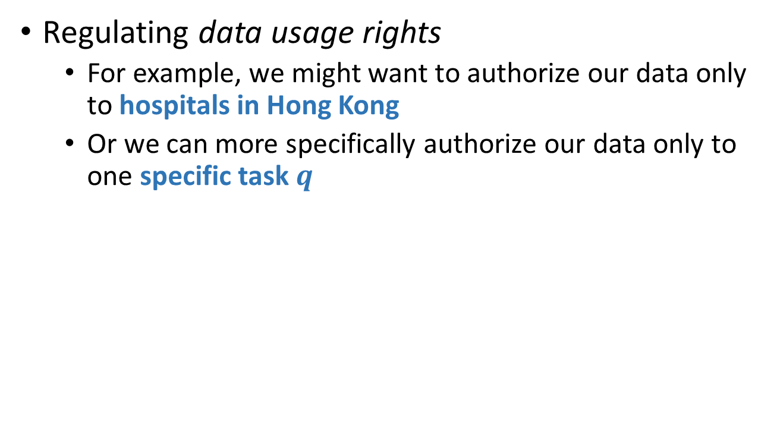
Controlling shared (encrypted) data
Regulating data usage rights
For example, we might want to authorize our data only to hospitals in Hong Kong
Or we can more specifically authorize our data only to one specific task $q$
Encrypted Data
Data Owner
Data Policy

Slide 6
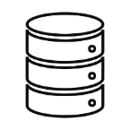




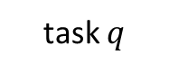
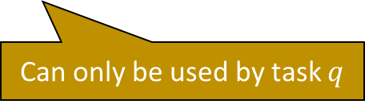
Metadata leakage problem
Encrypted Data
Data Owner
Data Policy
This owner might has cancer
Can only be used by task $q$
task $q$
Side-information via social media and Google search

Slide 7
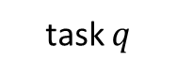
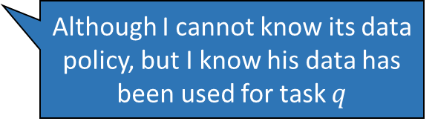
Metadata leakage problem (cont.)
Encrypted Data
Data Owner
Data Policy
Can only be used by task $q$
task $q$
Encrypted Data
Data access pattern leakage
Data Owner
Although I cannot know its data policy, but I know his data has been used for task $q$

Slide 8

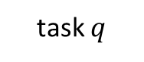
Traditional methods
Secure computation techniques (e.g., outsourced MPC, TEE or homomorphic encryption) + Oblivious RAM
Secure computation
Data Policy
Confidential environment
Oblivious data access
task $q$
Putting the entire database inside the secure computation is obviously NOT desirable
Encrypted Database

Slide 9
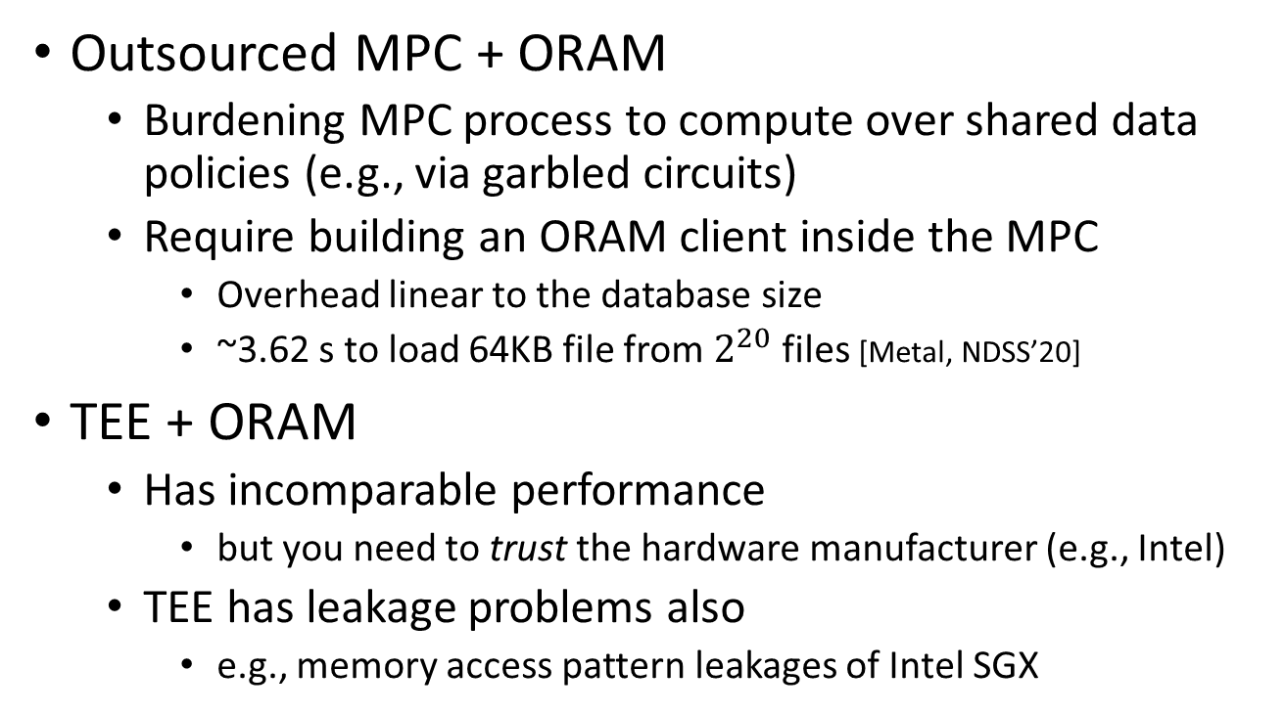
Existing methods
Outsourced MPC + ORAM
Burdening MPC process to compute over shared data policies (e.g., via garbled circuits)
Require building an ORAM client inside the MPC
Overhead linear to the database size
~3.62 s to load 64KB file from $2^{20}$ files [Metal, NDSS’20]
TEE + ORAM
Has incomparable performance
but you need to trust the hardware manufacturer (e.g., Intel)
TEE has leakage problems also
e.g., memory access pattern leakages of Intel SGX

Slide 10
Our starting point
The private subset histogram problem
Example: counting how many users have accessed a specific set of websites
Each owner 𝑖 holds a string (e.g., URLs) 𝑥 and the server holds a small set 𝑄 of strings.
The technique for computing private subset histogram reveals, for each string 𝜎 ∈ 𝑄, how many owners hold 𝜎 without leaking each owner’s secret string
We start from a recent construction from Boyle et al. [Function Secret Sharing: Improvements and Extensions, CCS’16]

Slide 11

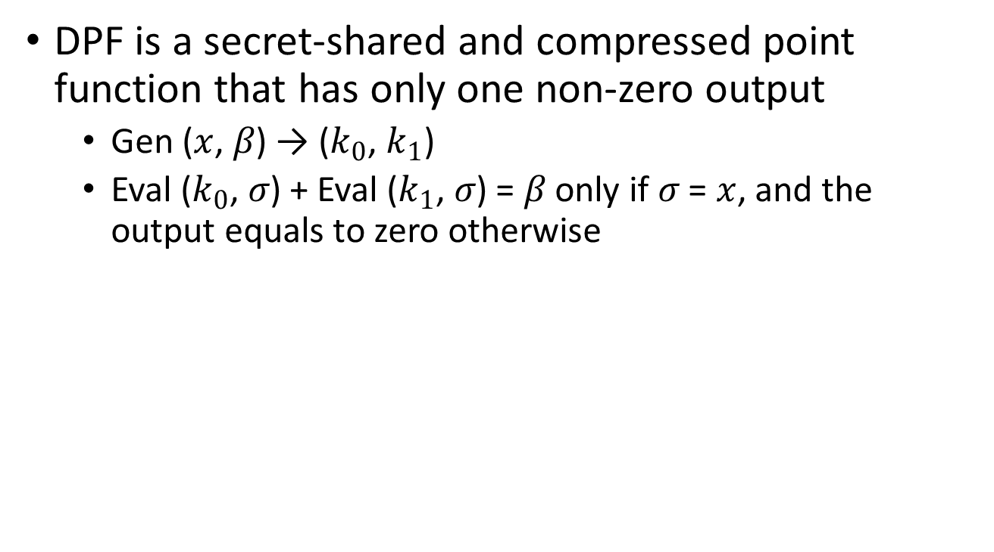
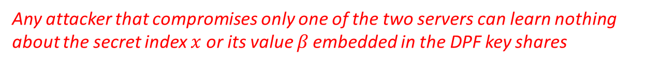
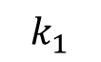
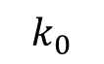
Distributed point function (DPF)
DPF is a secret-shared and compressed point function that has only one non-zero output
Gen ($x$, 𝛽) → ($k_{0}$, $k_{1}$)
Eval ($k_{0}$, 𝜎) + Eval ($k_{1}$, 𝜎) = 𝛽 only if 𝜎 = $x$, and the output equals to zero otherwise
Non-colluding
$$k_{0}$$
$$k_{1}$$
Server 0
Server 1
𝜎
Any attacker that compromises only one of the two servers can learn nothing about the secret index $x$ or its value 𝛽 embedded in the DPF key shares

Slide 12
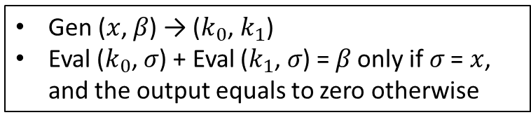
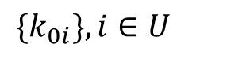
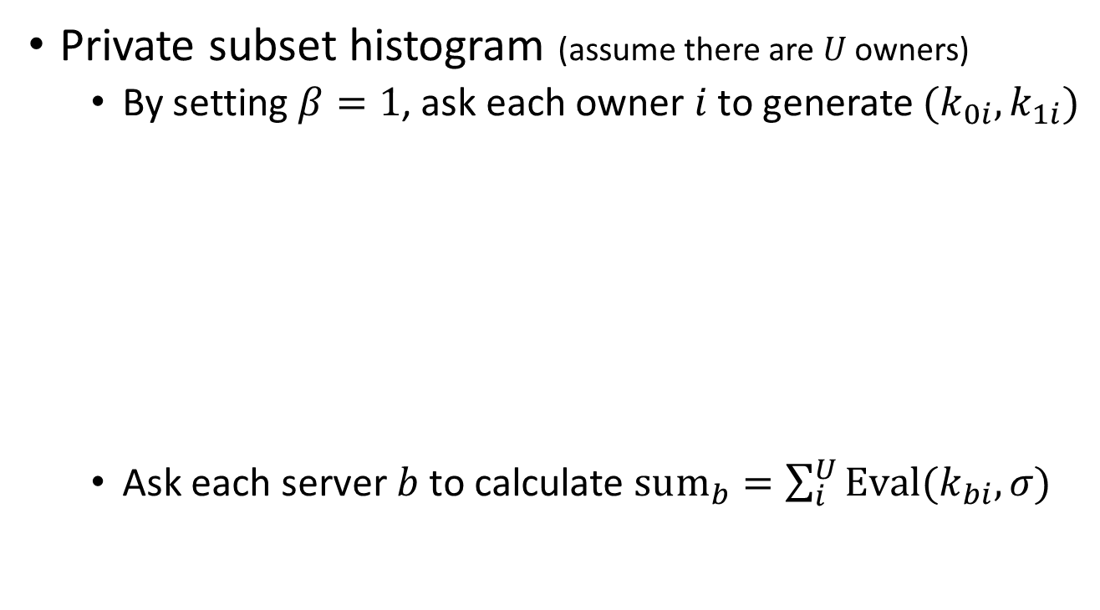
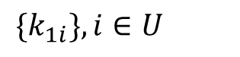
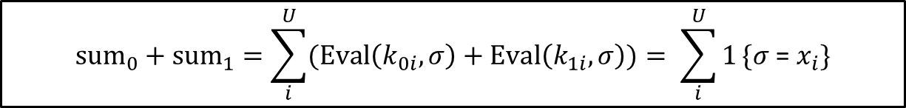
From DPF to …
Gen ($x$, 𝛽) → ($k_{0}$, $k_{1}$)
Eval ($k_{0}$, 𝜎) + Eval ($k_{1}$, 𝜎) = 𝛽 only if 𝜎 = $x$, and the output equals to zero otherwise
Private subset histogram (assume there are $U$ owners)
By setting $β=1$, ask each owner $i$ to generate $(k_{0i},k_{1i})$
Ask each server $b$ to calculate $sum_{b}=\sum_{i}^{U}{Eval(k_{bi},\text{σ})}$
Non-colluding
${\{k}_{0i}\}, i∈U$
${\{k}_{1i}\}, i∈U$
Server 0
Server 1
𝜎
$$sum_{0}+sum_{1}=\sum_{i}^{U}{(Eval\left(k_{0i},\text{σ}\right)+Eval\left(k_{1i},\text{σ}\right))}= \sum_{i}^{U}{1}\{\text{σ}\text{ = }x_{i}\}$$

Slide 13
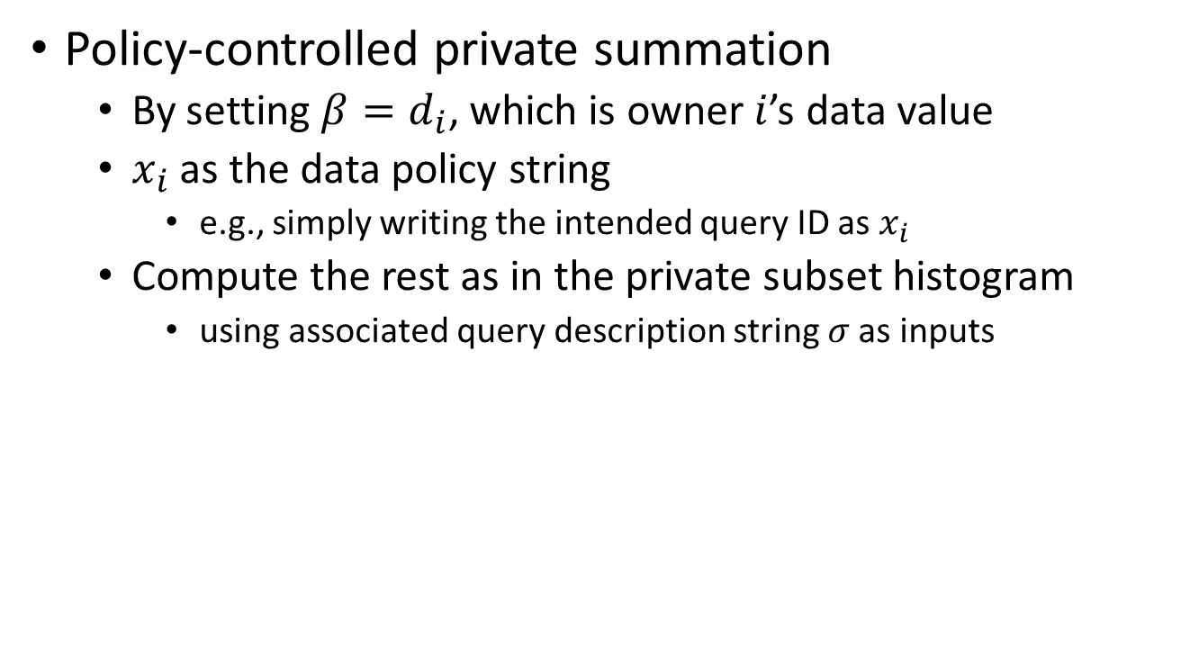
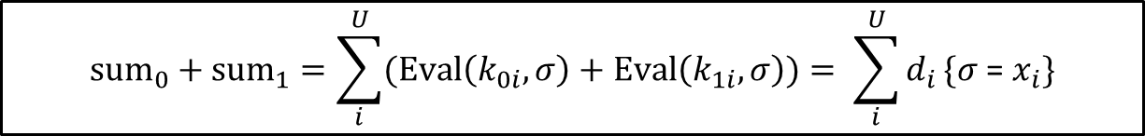
From DPF to …
Gen ($x$, 𝛽) → ($k_{0}$, $k_{1}$)
Eval ($k_{0}$, 𝜎) + Eval ($k_{1}$, 𝜎) = 𝛽 only if 𝜎 = $x$, and the output equals to zero otherwise
Policy-controlled private summation
By setting $β=d_{i}$, which is owner $i$’s data value
$x_{i}$ as the data policy string
e.g., simply writing the intended query ID as $x_{i}$
Compute the rest as in the private subset histogram
using associated query description string 𝜎 as inputs
$$sum_{0}+sum_{1}=\sum_{i}^{U}{(Eval\left(k_{0i},\text{σ}\right)+Eval\left(k_{1i},\text{σ}\right))}= \sum_{i}^{U}{d_{i}}\{\text{σ}\text{ = }x_{i}\}$$

Slide 14
What we have achieved… so far
Policy-controlled private summation
Allow each owner to specify their own policy
Protect data and policy confidentiality
Does NOT reveal which owner’s data has been used (since we go through all owners…)

Slide 15

What we have achieved… so far
Policy-controlled private summation
Allow each owner to specify their own policy
Protect data and policy confidentiality
Does NOT reveal which owner’s data has been used (since we go through all owners…)
Remaining challenges:
How to effectively support data streams?
Richer data policy options (e.g., complex ones with AND, OR, and NOT operators)
Policy enforcements (the two servers can deviate from the policy)

Slide 16




Our architectural vision
Analytic Queries
Online
Query Interface
Secure Data Processing Pipeline
Consumer
Result
Server 1
Server 2
Data Upload Interface
Encrypted Data Streams
Data Owner
Data Policy
Output
Other Release Policies
(privacy, payment based)
Result Release Control
Correctness checked, deliver. Discard otherwise

Slide 17
Integrity-based release policies
Straightforwardly, we can adopt verifiable MPC techniques here
MAC-based ones, SNARK-based ones
Problems: overhead to generate proofs are burdening to the two servers
We can weaken the threat assumption and prioritize efficiency
Rational economic servers
Will not intentionally collude and sabotage the task, but might work lazily to save their local expenses
One example: the “ringer” design

Slide 18
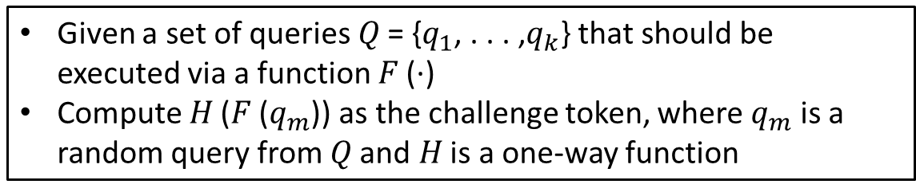
“Ringer”-based approach
Given a set of queries 𝑄 = {$q_{1}$, . . . ,$q_{k}$} that should be executed via a function 𝐹 (·)
Compute 𝐻 (𝐹 ($q_{m}$)) as the challenge token, where $q_{m}$ is a random query from 𝑄 and 𝐻 is a one-way function
Require adjustments to be used in our setting
as 𝐹 (·) can only be computed by the two servers or jointly by all owners
Simple solution - Owner-assisted approach
Owners select a representative periodically and jointly generate a large amount of challenge tokens
Insert the query to the two servers and the challenge token via the committee

Slide 19





Warping up
New metadata-hiding property to preserve user privacy against side information leakages
Query
Aggregation
Consumer
Supports owner-centric data policies to privately regulate data usage rights
Enables release policies to enhance data control and policy enforcements
Thank You! Questions?

